Slide 1

Towards Robust Detection of AI-Generated Videos: Challenges and Continual Learning Solutions
Yash Kailas Doke
Guide - Dr. B. D. Phulpagar Seminar
PES Modern College of Engineering Department of Computer Engineering Savitribai Phule Pune University
26-September-2025
Detection of AI-Generated Videos

Slide 2










Outline
Introduction Literature Survey Objectives and Scope Problem Statement Architectural Diagram Algorithmic Approach Input / Data sets
Results/Experimental Work Conclusion / Summary References
1
2
3
4
5
6
7
8
9
10
Detection of AI-Generated Videos

Slide 3
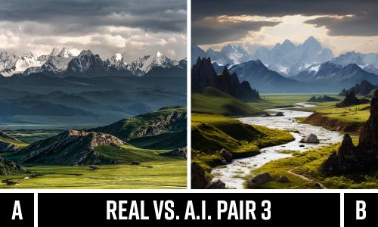
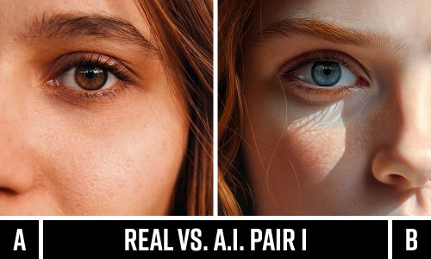
Introduction
AI video synthesis (T2V) is widespread — detection is critical for forensics and trust.
I propose a practical system that extracts SigLIP frame embeddings, trains a compact temporal transformer for fake-video detection.
It also employs lightweight adapters + replay + LwF to enable continual updates without catastrophic forgetting.
Goal: robust cross-dataset detection preserve performance after incremental updates.
Detection of AI-Generated Videos

Slide 4
Literature Survey(1/2)
Title | Author, Publication, Year | Technique | Remark
FaceForensics++ Benchmark | Rössler et al., ICCV 2019 | XceptionNet on spatial “X-Ray” maps | Highlights compression robustness challenges
DeepFake Detection Challenge (DFDC) | Dolhansky et al., CVPR Workshops 2020 | Ensemble CNNs with heavy augmentation | Exposes large generalization gap on hidden test set
Audio-Visual Deepfake Detection (LipForensics) | Haliassos et al., CVPR Workshops 2021 | Lip-audio synchrony + multimodal fusion | Robust under compression and noisy audio conditions
Table 1:-Literature Survey
Detection of AI-Generated Videos

Slide 5
Literature Survey(2/2)
Title | Author, Publication, Year | Technique | Remark
Continual Deepfake Detection Benchmark (CDDB) | Kundu et al., CVPR 2023 | RAWM & DMP continual learning | Demonstrates catastrophic forgetting and benefits of replay methods
GenVidBench Cross-Generator Benchmark | Zhao et al., CVPR 2024 | ViT-based full-scene detection | Shows near-chance performance of face-centric models
UNITE: Universal Synthetic Video Detector | Zhang et al., NeurIPS 2025 | Vision Transformer + Attention-Diversity Loss | Universal coverage across face, background, and full-scene synthetic videos
Table 2:-Literature Survey
Detection of AI-Generated Videos

Slide 6
Objectives and Scope
Objectives:
Develop a universal detection framework for diverse AI-generated content
Address limitations of face-centric detection approaches
Create an adaptive system using continual learning principles
Achieve robust cross-domain generalization performance
Scope:
Cover multiple synthesis types: face manipulation, background synthesis, full-scene generation
Implement continual learning with experience replay and knowledge distillation
Evaluate across diverse datasets including emerging generators
Detection of AI-Generated Videos

Slide 7
Problem Statement
“Automate detection of AI-generated videos (fake vs real) using frame embeddings and a temporal model; maintain performance under continual arrivals.”
Specific Research Problems:
Cross-generator generalization failure
Attention bias toward facial regions only
Catastrophic forgetting when adapting to new threats
Limited coverage of full-scene synthetic content
Inability to continuously learn from emerging manipulations
Detection of AI-Generated Videos

Slide 8
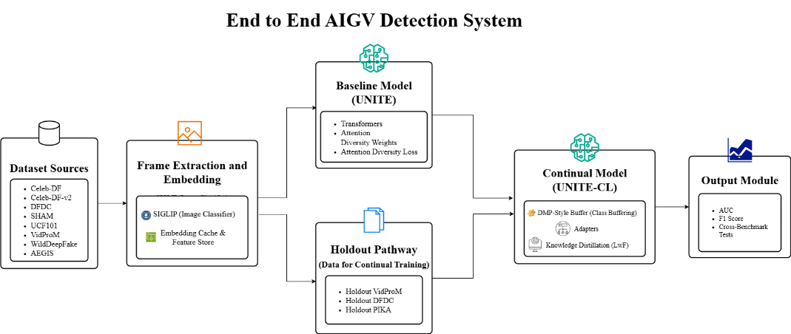
Architectural Diagram
Figure: 1.System Architectural Diagram.
Detection of AI-Generated Videos

Slide 9
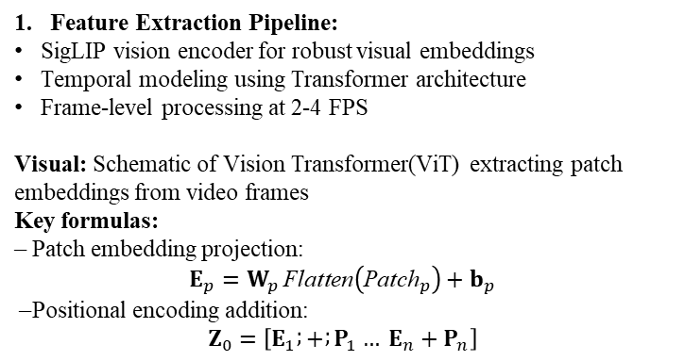
Algorithmic Approach(1/4)
Feature Extraction Pipeline:
SigLIP vision encoder for robust visual embeddings
Temporal modeling using Transformer architecture
Frame-level processing at 2-4 FPS
Visual: Schematic of Vision Transformer(ViT) extracting patch embeddings from video frames
Key formulas: – Patch embedding projection: $$E_{p}=W_{p} \text{Flatten}\left({\text{Patch}}_{p}\right)+b_{p}$$ – Positional encoding addition: $$Z_{0}=\left[E_{1} ; + ; P_{1}… E_{n}+P_{n}\right]$$
Detection of AI-Generated Videos

Slide 10
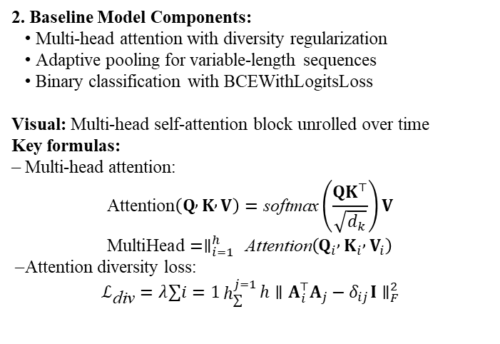
Algorithmic Approach(2/4)
2. Baseline Model Components:
• Multi-head attention with diversity regularization
• Adaptive pooling for variable-length sequences
• Binary classification with BCEWithLogitsLoss
Visual: Multi-head self-attention block unrolled over time
Key formulas: – Multi-head attention: $$\text{Attention}\left(Q , K , V\right)=\text{softmax}\left(\frac{{QK}^{⊤}}{\sqrt{d_{k}}}\right)V \\ \text{MultiHead}=∥_{i=1}^{h} \text{Attention}\left(Q_{i} , K_{i} , V_{i}\right)$$ – Attention diversity loss: $$ℒ_{\text{div}}=λ∑i=1h_{∑}^{j=1}{h}∥A_{i}^{⊤}A_{j}−δ_{ij}I∥_{F}^{2}$$
Detection of AI-Generated Videos

Slide 11
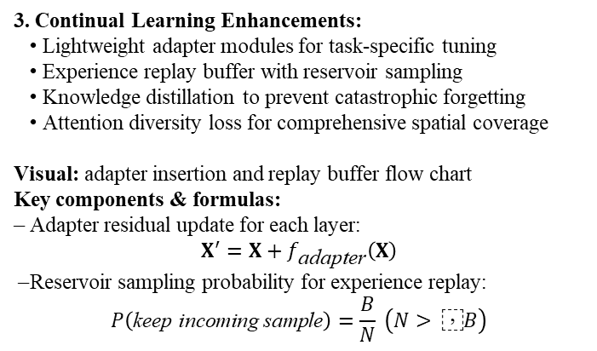
Algorithmic Approach(3/4)
3. Continual Learning Enhancements:
• Lightweight adapter modules for task-specific tuning
• Experience replay buffer with reservoir sampling
• Knowledge distillation to prevent catastrophic forgetting
• Attention diversity loss for comprehensive spatial coverage
Visual: adapter insertion and replay buffer flow chart
Key components & formulas: – Adapter residual update for each layer: $$X^{′}=X+f_{\text{adapter}}\left(X\right)$$ – Reservoir sampling probability for experience replay: $$P\left(\text{keep} \text{incoming} \text{sample}\right)=\frac{B}{N} \left(N> \text{⁣}B\right)$$
Detection of AI-Generated Videos

Slide 12
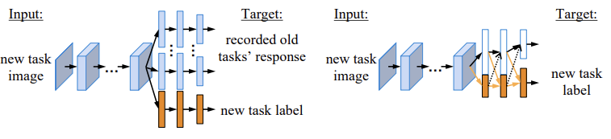
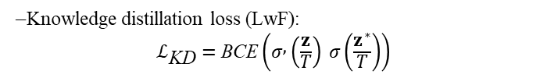

Algorithmic Approach(4/4)
– Knowledge distillation loss (LwF): $$ℒ_{\text{KD}}=\text{BCE}\left(σ , \left(\frac{z}{T}\right) σ\left(\frac{z^{∗}}{T}\right)\right)$$
– Total training loss: $$ℒ=ℒ_{\text{BCE}}+α ℒ_{\text{div}}+β ℒ_{\text{KD}}+γ ℒ_{\text{replay}}$$
Detection of AI-Generated Videos

Slide 13
Dataset
Dataset | Type | Number of Videos | Label Distribution (fake/real)
Celeb-DF | Face swap | 1203 | 50% / 50%
Celeb-DF-v2 | Face swap enhanced | 6529 | 50% / 50%
DFDC | Mixed manipulations | 14,343 | 50% / 50%
SHAM | Synthetic face sequences | 704 | 50% / 50%
UCF101 | Real-world actions | 13,320 | 0% / 100%
VidProM | Text-to-video (Pika) | 8,000 | 100% / 0%
WildDeepfake | In-the-wild deepfakes | 2,000 | 50% / 50%
AEGIS | Professional deepfakes | 2,000 | 50% / 50%
Detection of AI-Generated Videos

Slide 14
Results
Dataset | Baseline Accuracy | Continual Accuracy | Baseline AUC | Continual AUC
Celeb-DF | 91.2% | 92.4% | 0.88 AUC | 0.90 AUC
DFDC | 82.08% | 82.87% | 0.75 AUC | 0.78 AUC
WildDeepfake | 68.5% | 72.7% | 0.62 AUC | 0.66 AUC
VidProM | 82.1% | 85.4% | 0.80 AUC | 0.83 AUC
AEGIS | 72.4% | 75.9% | 0.74 AUC | 0.78 AUC
Detection of AI-Generated Videos

Slide 15
Conclusion
Key Contributions:
• First universal synthetic video detector addressing full-scene generation.
• Novel continual learning framework preventing catastrophic forgetting.
• Attention diversity mechanism ensuring comprehensive spatial coverage.
• Extensive cross-dataset evaluation demonstrating generalization.
Future Work:
• Integration with multimodal detection (audio-visual).
• Real-time optimization for streaming applications.
• Extension to handle video-to-video translation.
Detection of AI-Generated Videos

Slide 16
References I
Kundu, R., Xiong, H., Mohanty, V., Balachandran, A., & Roy-Chowdhury, A. K. (2025). Towards a Universal Synthetic Video Detector: From Face or Background Manipulations to Fully AI-Generated Content. CVPR 2025. https://openaccess.thecvf.com/content/CVPR2025/papers/Kundu_Towards_a_Universal_Synthetic_Video_Detector_From_Face_or_Background_CVPR_2025_paper.pdf
Li, Y., et al. (2023). A Continual Deepfake Detection Benchmark, Dataset, Methods and Essentials. WACV 2023. https://openaccess.thecvf.com/content/WACV2023/papers/Li_A_Continual_Deepfake_Detection_Benchmark_Dataset_Methods_and_Essentials_WACV_2023_paper.pdf
FaceForensics++ Dataset. Rossler, A., Cozzolino, D., Verdoliva, L., Riess, C., Thies, J., & Nießner, M. (2019). FaceForensics++: Learning to detect manipulated facial images. https://github.com/ondyari/FaceForensics
DeepFake Detection Challenge (DFDC). https://arxiv.org/pdf/2006.07397.pdf
GenVidBench Dataset. https://arxiv.org/pdf/2501.11340.pdf
Detection of AI-Generated Videos

Slide 17
References II
Li, Y., et al. (2020). Face X-Ray for More General Face Forgery Detection. CVPR 2020. https://openaccess.thecvf.com/content_CVPR_2020/papers/Li_Face_X-Ray_for_More_General_Face_Forgery_Detection_CVPR_2020_paper.pdf
Liu, S., et al. (2021). Spatial-Phase Shallow Learning: Rethinking Face Forgery Detection in Frequency Domain. ICCV 2021. https://openaccess.thecvf.com/content/ICCV2021/papers/Liu_Spatial-Phase_Shallow_Learning_Rethinking_Face_Forgery_Detection_in_Frequency_Domain_ICCV_2021_paper.pdf
Haliassos, A., et al. (2021). Lips Don’t Lie: A Generalisable and Robust Approach To Face Manipulation Detection. CVPR 2021. https://openaccess.thecvf.com/content/CVPR2021/papers/Haliassos_Lips_Dont_Lie_A_Generalisable_and_Robust_Approach_To_Face_CVPR_2021_paper.pdf
Wang, J., Yuan, H., Chen, D., Zhang, Y., Wang, X., & Zhang, S. (2023). Modelscope Text-to-Video Technical Report. arXiv:2308.06571
Additional references on continual learning and knowledge distillation, including Li et al. (2016) on Learning without Forgetting (LwF).
Detection of AI-Generated Videos

Slide 18

Detection of AI-Generated Videos

Slide 19
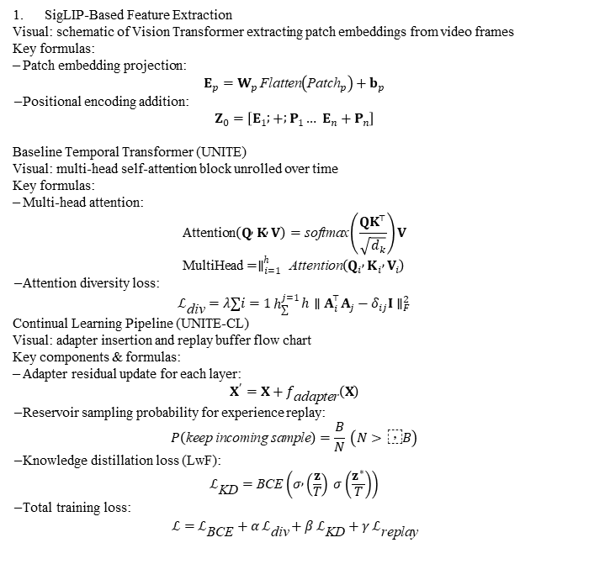
SigLIP-Based Feature Extraction
Visual: schematic of Vision Transformer extracting patch embeddings from video frames
Key formulas: – Patch embedding projection: $$E_{p}=W_{p} \text{Flatten}\left({\text{Patch}}_{p}\right)+b_{p}$$ – Positional encoding addition: $$Z_{0}=\left[E_{1} ; + ; P_{1}… E_{n}+P_{n}\right]$$
Baseline Temporal Transformer (UNITE)
Visual: multi-head self-attention block unrolled over time
Key formulas: – Multi-head attention: $$\text{Attention}\left(Q , K , V\right)=\text{softmax}\left(\frac{{QK}^{⊤}}{\sqrt{d_{k}}}\right)V \\ \text{MultiHead}=∥_{i=1}^{h} \text{Attention}\left(Q_{i} , K_{i} , V_{i}\right)$$ – Attention diversity loss: $$ℒ_{\text{div}}=λ∑i=1h_{∑}^{j=1}{h}∥A_{i}^{⊤}A_{j}−δ_{ij}I∥_{F}^{2}$$
Continual Learning Pipeline (UNITE-CL)
Visual: adapter insertion and replay buffer flow chart
Key components & formulas: – Adapter residual update for each layer: $$X^{′}=X+f_{\text{adapter}}\left(X\right)$$ – Reservoir sampling probability for experience replay: $$P\left(\text{keep} \text{incoming} \text{sample}\right)=\frac{B}{N} \left(N> \text{⁣}B\right)$$ – Knowledge distillation loss (LwF): $$ℒ_{\text{KD}}=\text{BCE}\left(σ , \left(\frac{z}{T}\right) σ\left(\frac{z^{∗}}{T}\right)\right)$$ – Total training loss: $$ℒ=ℒ_{\text{BCE}}+α ℒ_{\text{div}}+β ℒ_{\text{KD}}+γ ℒ_{\text{replay}}$$

